Slide 1
QUIT QUEUE Presented by: Sonali Shukla Sreeram Rachakonda Trainer: Javeed Mohammed Trainer: Javeed Mohammad

Slide 2
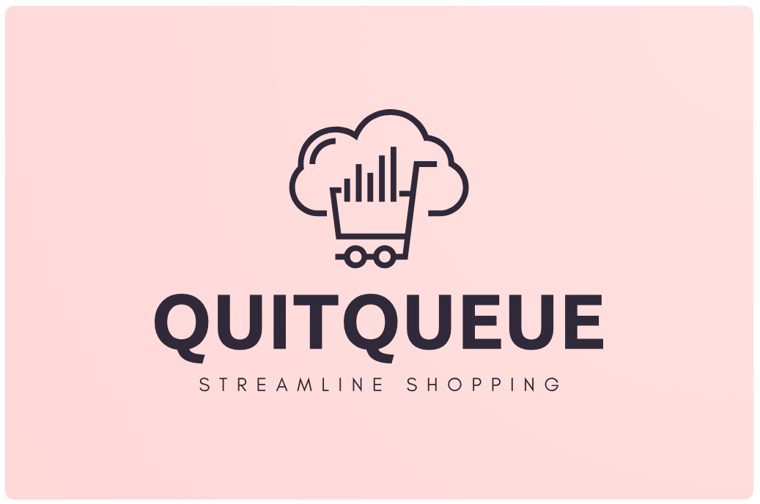

Slide 3
Technologies Used
Spring Boot
MySQL Database
JWT Authentication and Authorization
Sonar Lint
TypeScript
Angular
Local Storage
Router Guards
Twilio API
JsPDF

Slide 4
About
Quitqueue is a comprehensive online retail platform that serves as a one-stop destination for electronics, furniture, and clothing. Committed to delivering high-quality products and exceptional service, Quitqueue believes in offering a diverse range of products to meet the varied needs of its customers. Whether individuals are seeking the latest electronic gadgets, stylish furniture pieces, or trendy clothing, Quitqueue aims to cater to all preferences. The company's mission revolves around making online shopping convenient, enjoyable, and reliable for every customer. With a focus on providing a user-friendly interface, secure payment options, and prompt delivery services, Quitqueue strives to exceed customer expectations with every purchase.

Slide 5
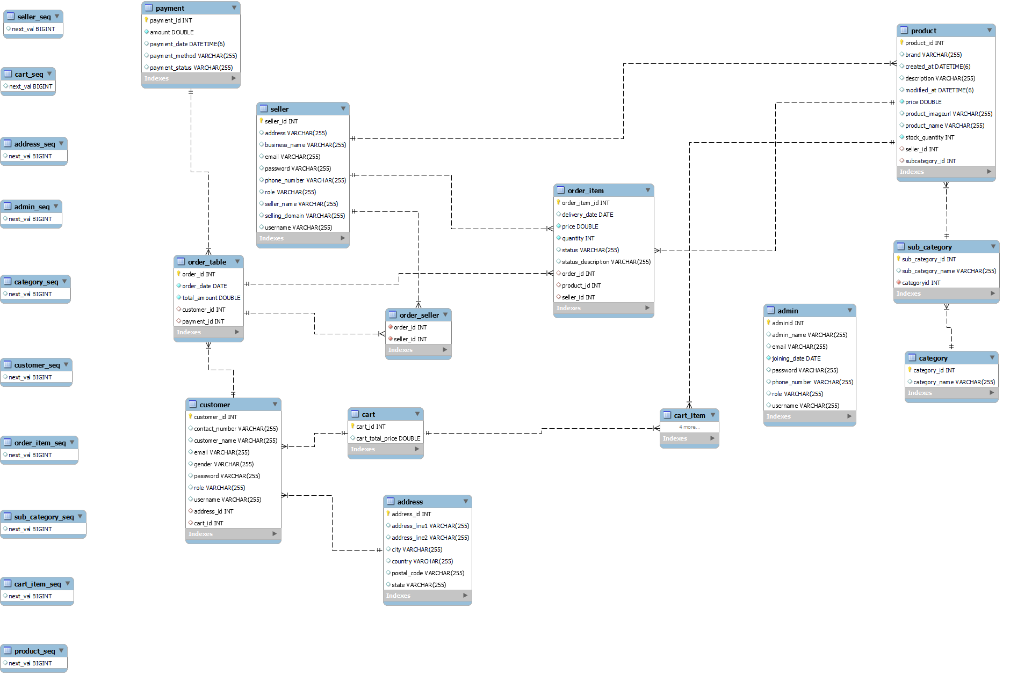

Slide 6
MODULES
Quitqueue operates with three distinct modules and can be accessed and operated by administrators, sellers, and customers alike. These modules facilitate seamless interaction and transactions among all parties involved in the platform. Admin Module: The Admin module in Quitqueue serves as the backbone of the platform, providing comprehensive control over all operations. Administrators have access to manage product listings, monitor transactions, and oversee user activities. They are responsible for maintaining the integrity of the platform by managing the overall functionality of Quitqueue. Seller Module: The Seller module empowers merchants and vendors to showcase their products and reach a wider audience. Sellers can create and manage their product listings, update inventory, and track sales performance through this module. The Seller module in Quitqueue facilitates seamless interaction between sellers and customers, through order services enabling businesses to thrive in the online marketplace. Customer Module: The Customer module is designed to enhance the shopping experience for users browsing through Quitqueue. Customers can explore a wide range of products, and make purchases securely. They have access to personalized account features, such as order tracking, and customer support. The Customer module allows to engage with sellers, fostering a dynamic and interactive online shopping environment.

Slide 7
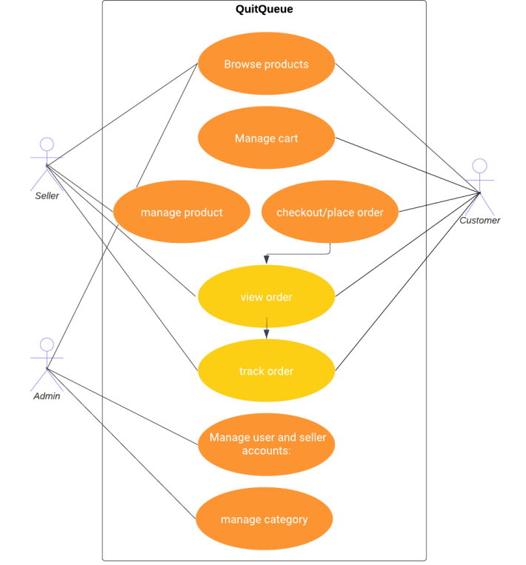

Slide 8
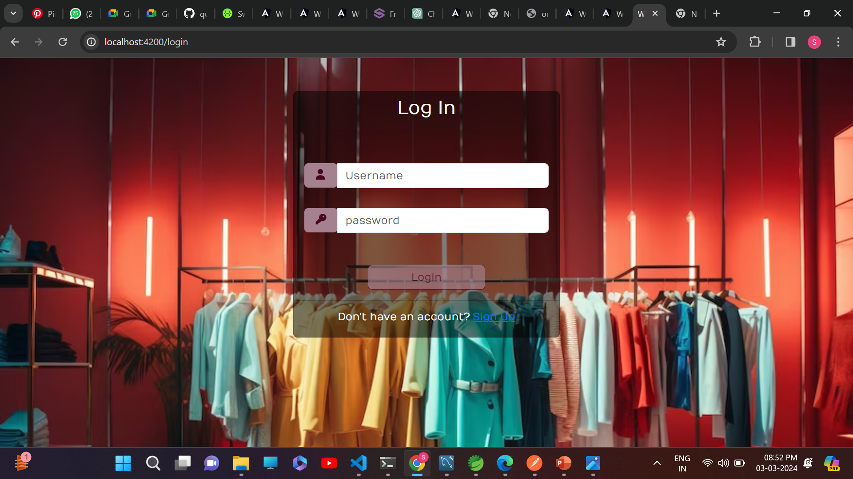

Slide 9
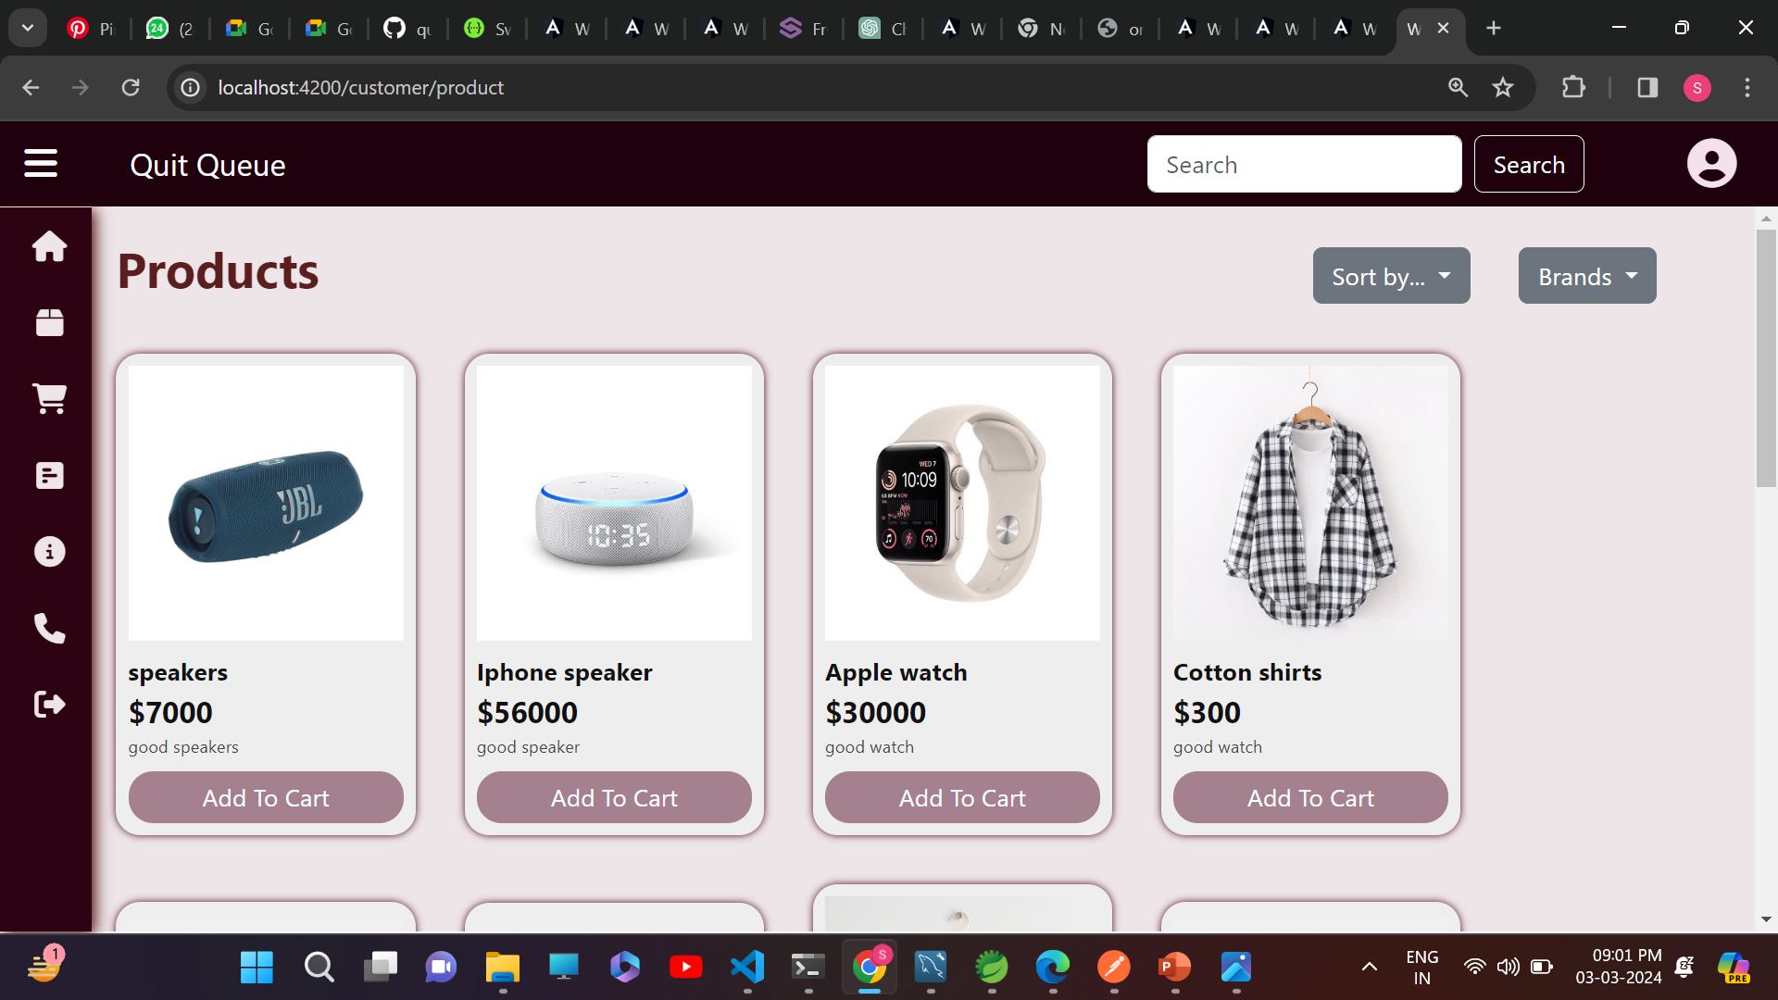
Cutomer Dashboard

Slide 10
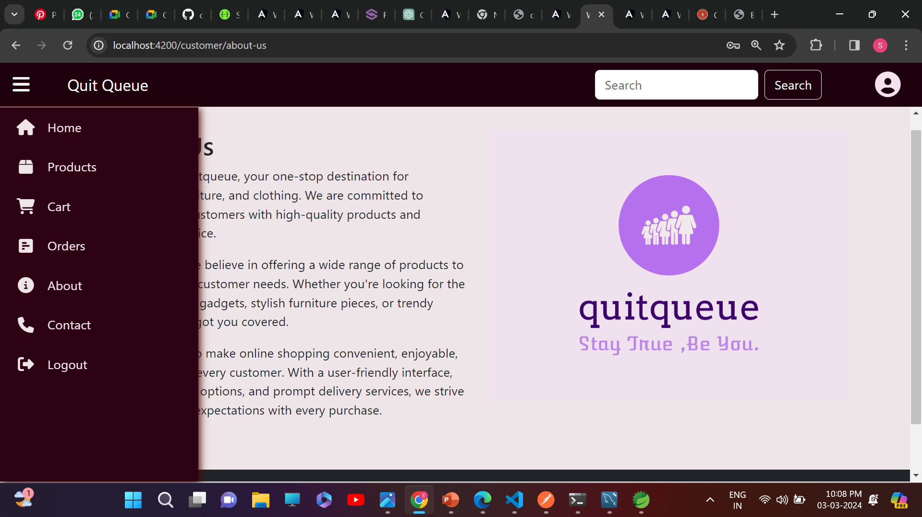

Slide 11
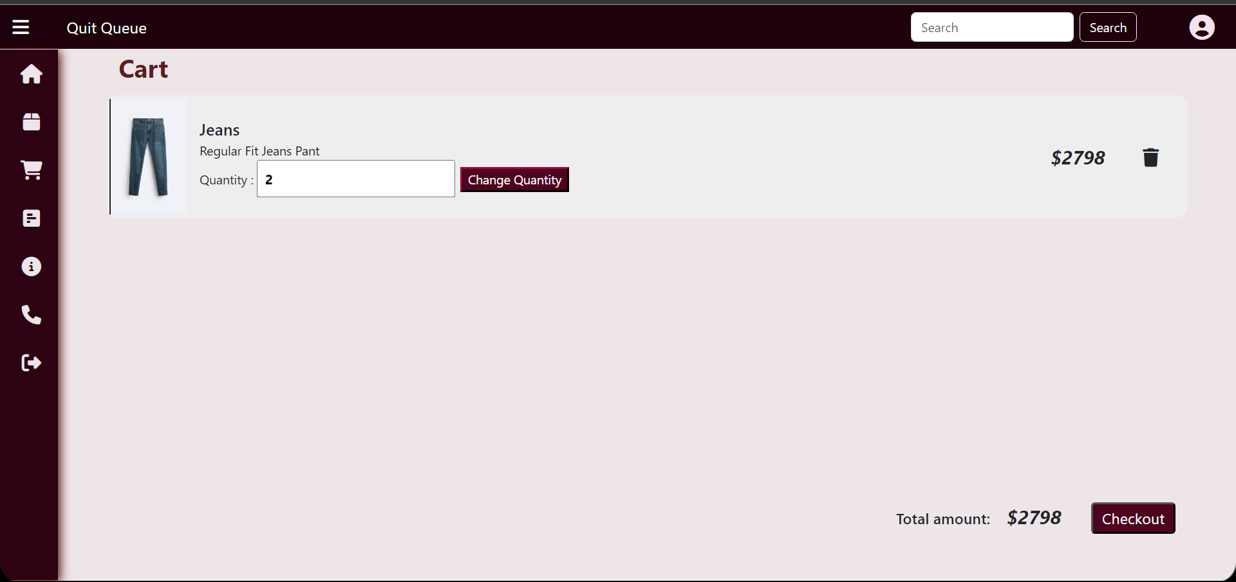

Slide 12
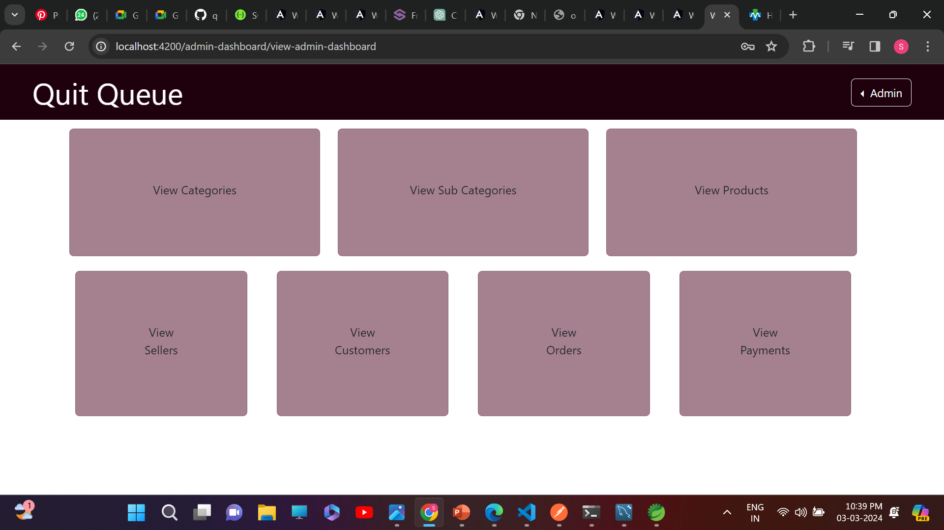
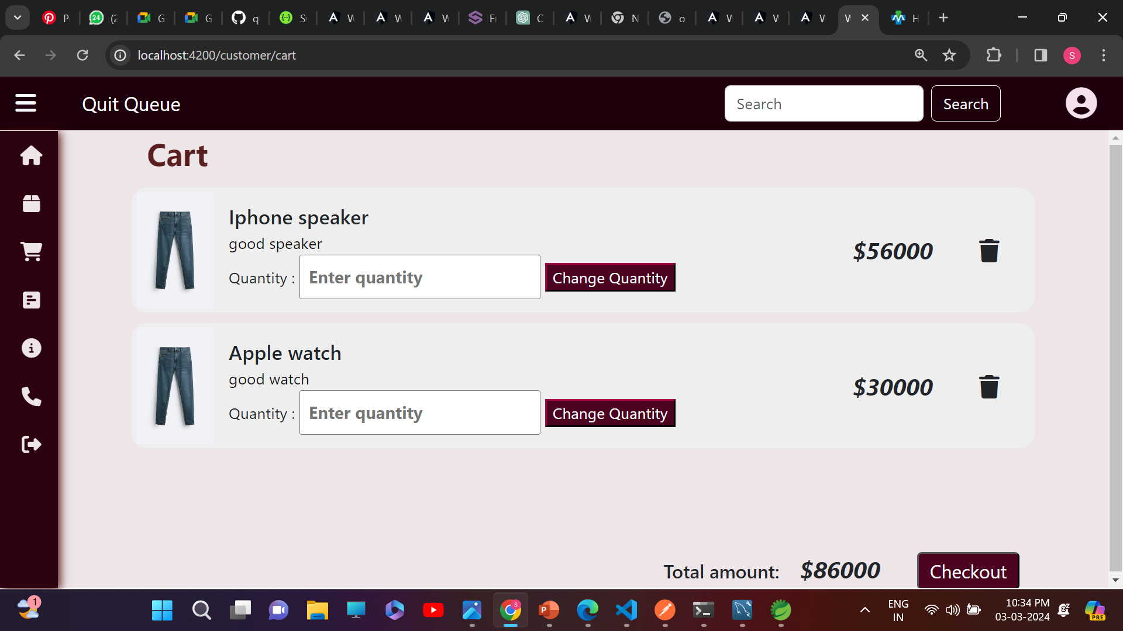
Admin Dashboard

Slide 13
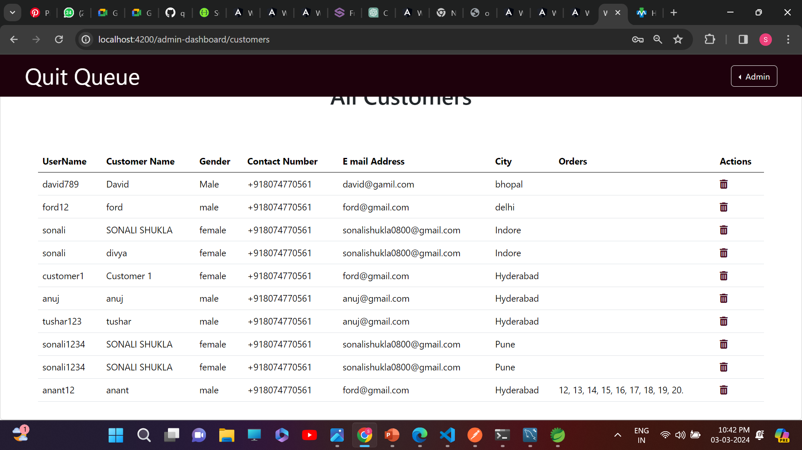

Slide 14
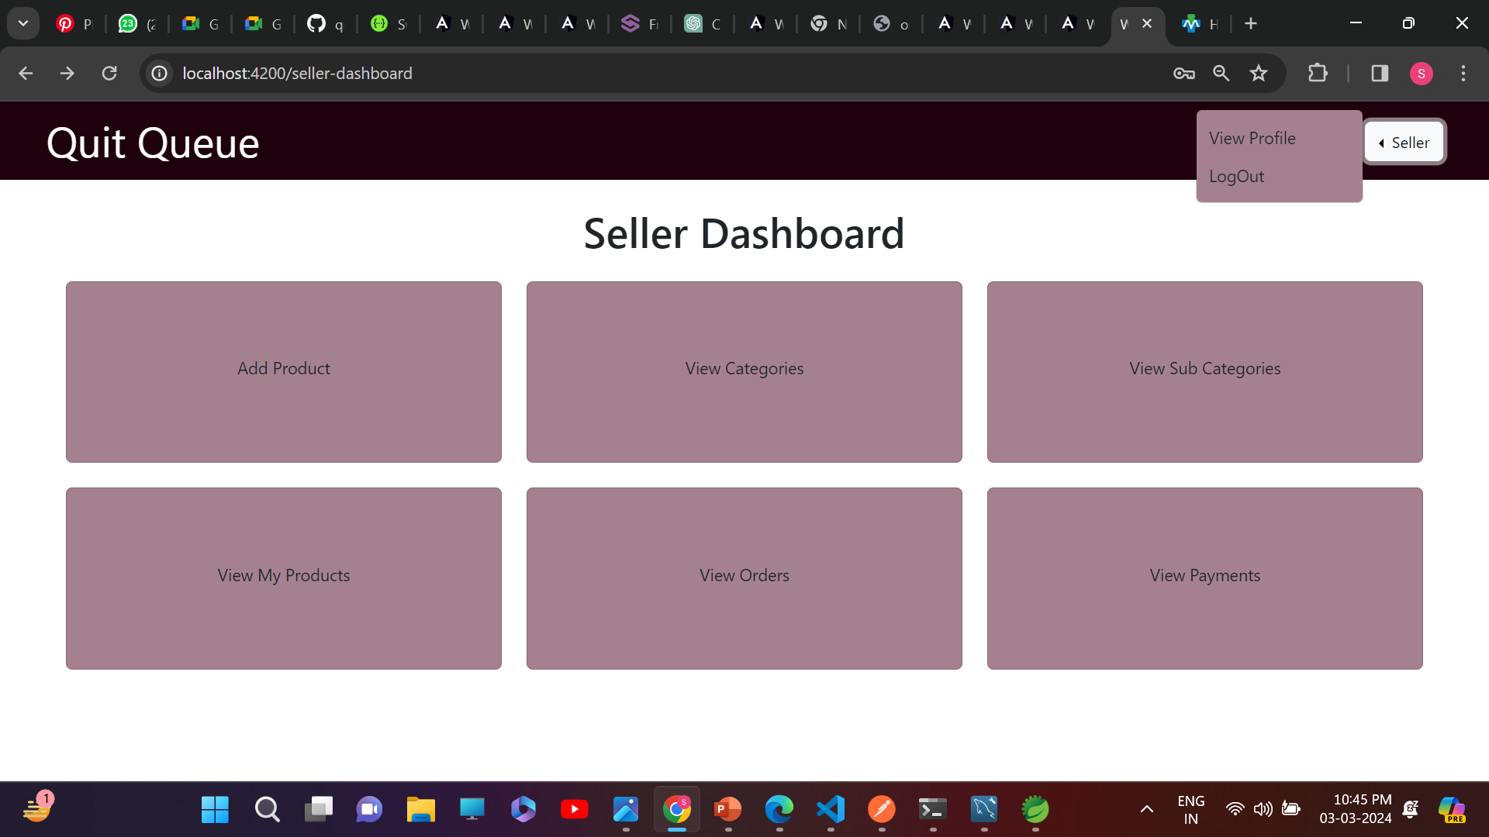
Seller Dashboard

Slide 15
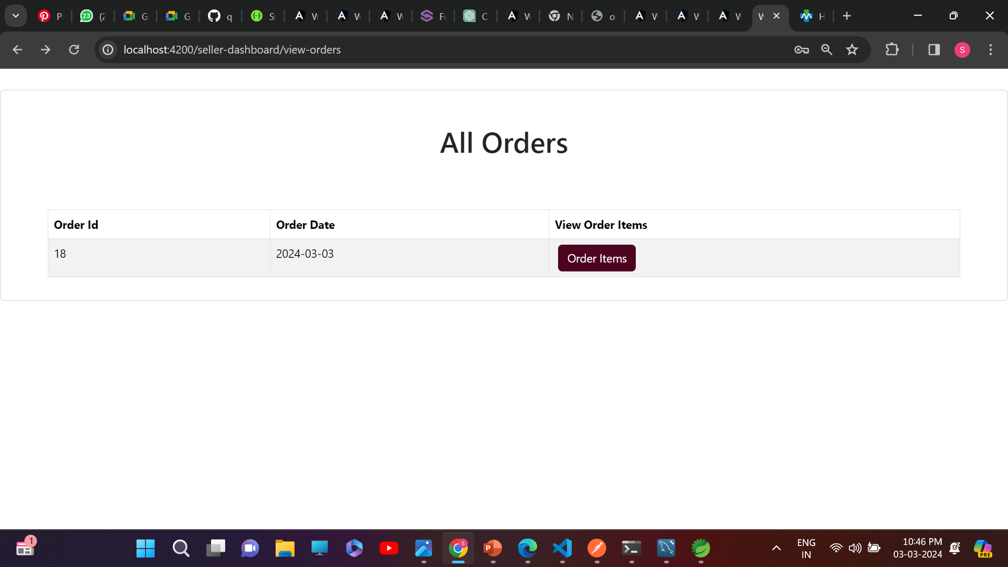

Slide 16
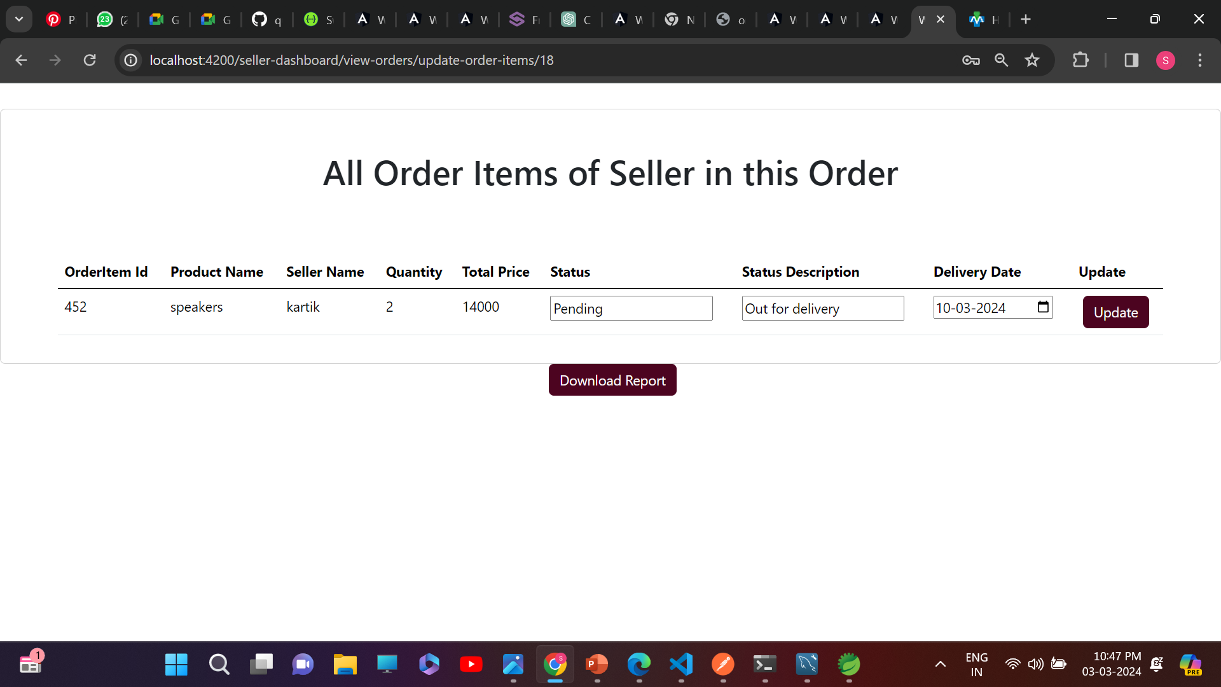

Slide 17
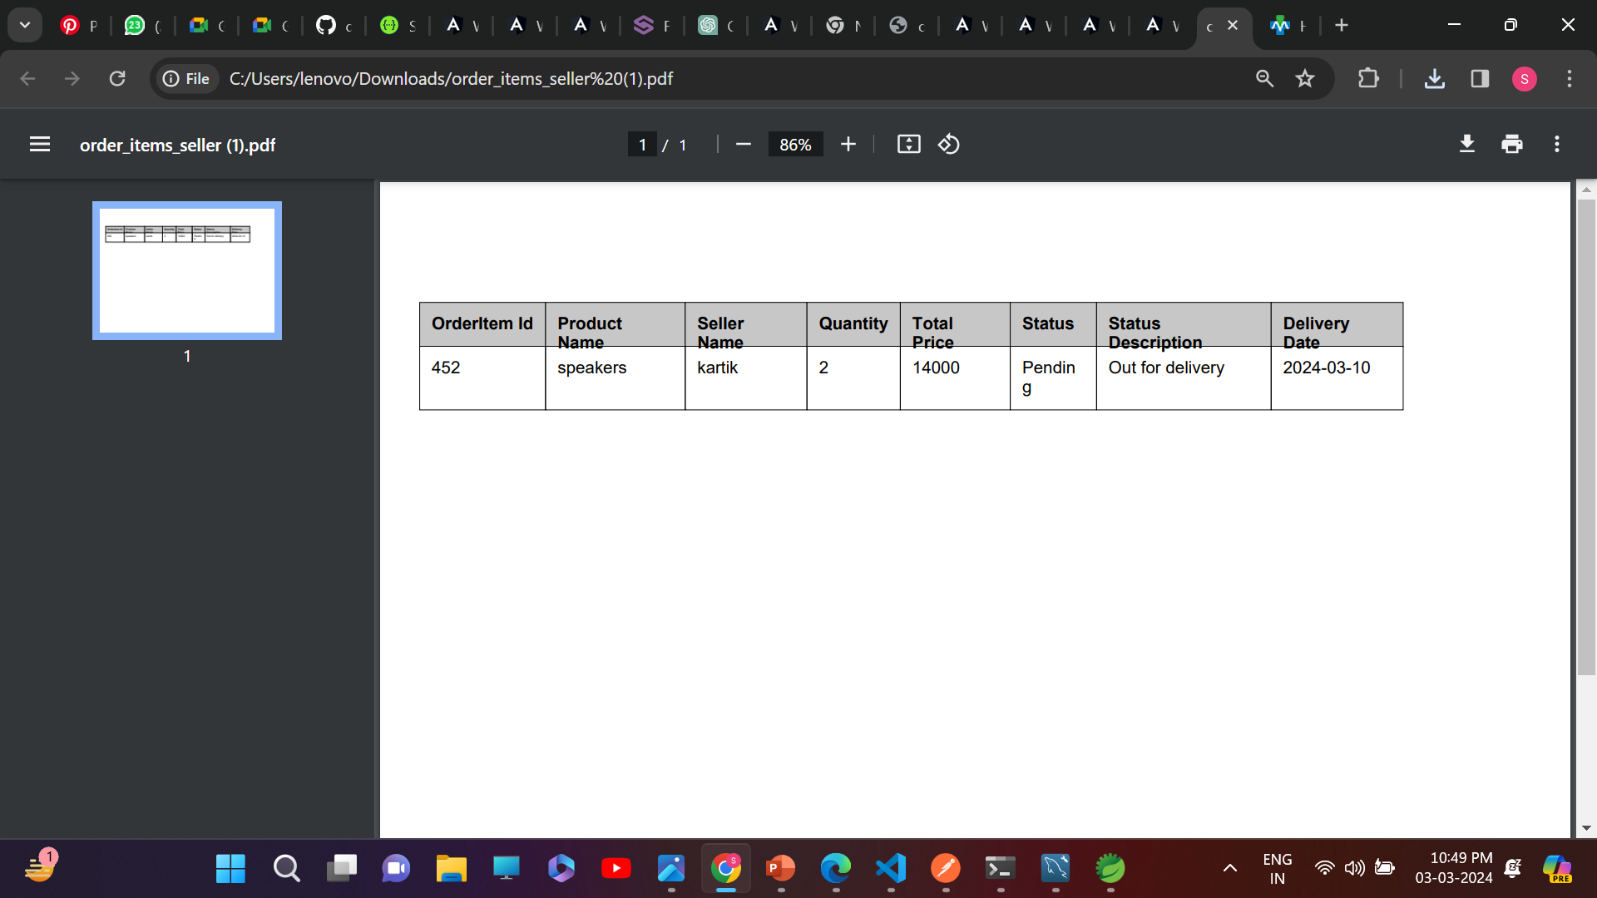

Slide 18
References
YouTube
W3 Schools
Online documentations

Slide 19
Thank You

